Slide 1
Introduction to scRNA-seq and data preprocessing
Jeremy M. Simon, Ph.D.
Senior Research Scientist
Dana-Farber Cancer Institute | Department of Data Science
Harvard T.H. Chan School of Public Health | Department of Biostatistics
jsimon@ds.dfci.harvard.edu

Slide 2
Outline for workshop
Part I
Rationale: Why do single-cell RNA-seq?
Overview of experimental methodologies/platforms
Best practices for experimental design
Overview of data processing tools
Part II
Workshop: Pre-processing scRNA-seq data using alevin-fry
All slides, code, and recordings will be available afterwards. If you have issues with downloading, installing, or running any of the code here today, don’t panic!
We may not be able to get it resolved live but this should all be doable at-your-own-pace later

Slide 3
Part I
Introduction to scRNA-seq: theory, platforms, biological considerations, and current best practices

Slide 4
Why single-cell RNA-seq?
Complex tissues contain lots of diverse cell types at different proportions
Profiling gene expression of tissue in bulk provides essentially a population-wide average, which can vary based on cellular composition
 | Green | Blue | Orange | Black | TISSUE
GeneA | 10 | 5 | 15 | 50 | 20
GeneB | 2 | 50 | 20 | 0 | 18
GeneC | 3 | 3 | 3 | 3 | 3
GeneD | 50 | 0 | 40 | 10 | 25
GeneE | 0 | 10 | 40 | 10 | 15

Slide 5
Why single-cell RNA-seq?
Condition 1
Condition 2
Scenario 1:
Altered proportions
In either scenario, bulk RNA-seq would likely have insufficient power to detect these differences
Condition 1
Condition 2
Scenario 2:
Altered expression
in subset of cells
Cell type A
Cell type B
Cell type C
Cell type D
Cell type D’

Slide 6
Why single-cell RNA-seq?
Condition 1
Condition 2
Scenario 1
Condition 2
Scenario 2
Bulk
Traditional
solution:
FACS-sorted
Green | 7
Blue | 7
Orange | 5
Black | 5
Green | 7
Blue | 7
Orange | 3*
Black | 8*
Green | 7
Blue | 7
Orange | 5
Black | 5

Slide 7
Why single-cell RNA-seq?
FACS sorting can detect proportional shifts in cell types, provided enough cells and strong selective markers
Sorting is unlikely to detect effects in subsets of cell types, and may still be underpowered even if followed by RNA-seq
For complex tissues, all of this is cost-prohibitive, and often the effect is unknown

Slide 8
Single-cell RNA-seq using 10X
Co-capture individual cells with barcoded beads
Typically 3’ based with oligo-dT amplification, but 5’ also an option
After sequencing, deconvolute which detected transcripts came from which cells
One “inlet” of 10X lane can only process ~10k cells, and by default only 1 experimental condition at a time
More on this later
https://mccarrolllab.org/dropseq/

Slide 9
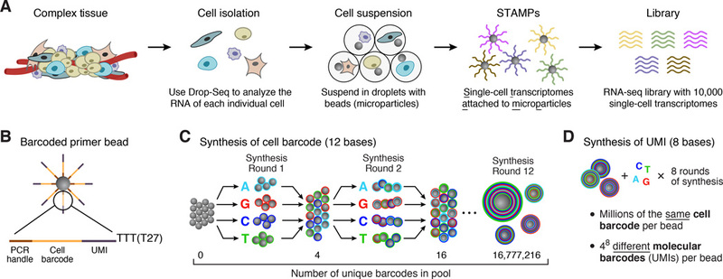
Single-cell RNA-seq via droplet microfluidics (10X, inDrop, Drop-seq)
Prepare tagged beads (this is done commercially)
Prepare single-cell solution (this is done by the lab)
Macosko et al, Cell, 2015

Slide 10
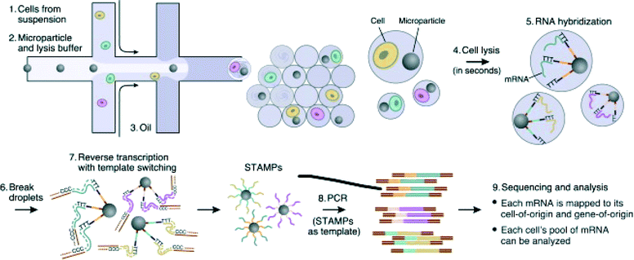
Single-cell RNA-seq via droplet microfluidics (10X, inDrop, Drop-seq)
Macosko et al, Cell, 2015

Slide 11
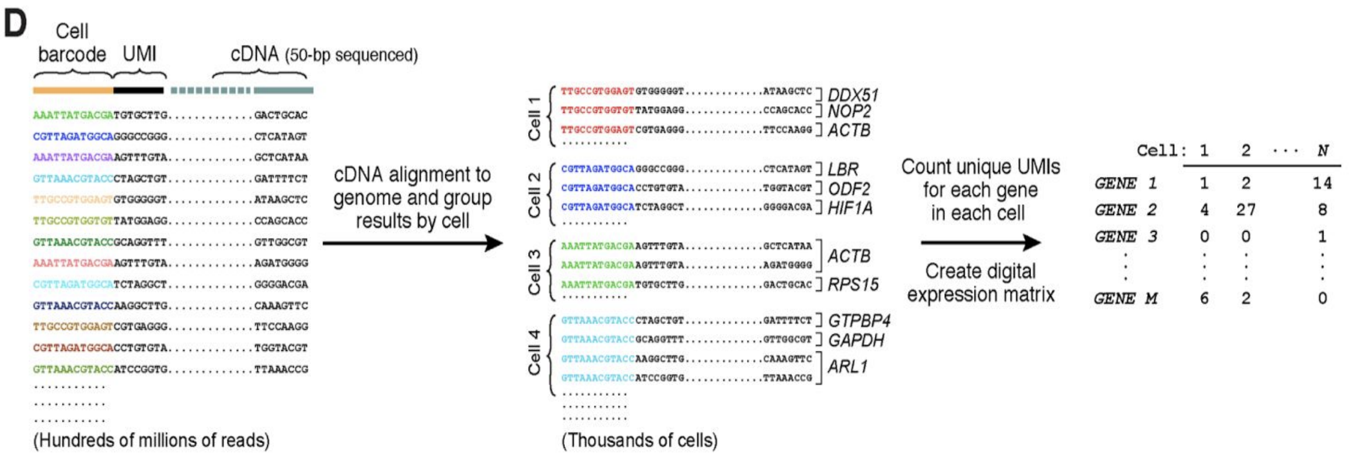
Deconvolution of barcodes determines which cells express which genes
Macosko et al, Cell, 2015

Slide 12
Brief overview of data processing
Deconvolute cell/molecular barcodes + error correction
Alignment
Selection of “real” cells vs obvious debris/noise
Determine which reads came from which transcripts
Construct cells x genes data matrix
R2.fastq
R1.fastq
@K00270:34:HGWWGBBXX:1:1101:1641:1279 1:N:0:NGAGCTAC
TGAACGTAGGCGGGGAAGAG
+
AAAFFJJJJJJJJJJJJFJJ
@K00270:34:HGWWGBBXX:1:1101:1945:1279 1:N:0:NGAGCTAC
GGTACATGTAGTATACCTTT
+
AAFFFJJJJJJJJJJJJJJJ
@K00270:34:HGWWGBBXX:1:1101:29437:1894 2:N:0:GGAGCTAC
GAAGAATCCGAGGAGTCTGATGATGACATGGGCTTTGATCTATTTGAATA
+
A<<AAJ<A7FF<7-7-7-7F--JA-JAJ<-7-7-7----<------7--<
@K00270:34:HGWWGBBXX:1:1101:29680:1894 2:N:0:GAAGCTAC
ATGCTATTCATGTCTTTATACAACTAAAGCTGATCTGACTGAGCATGTCA
+
-<-7-77A<--<A----<<7FF<A-7F<-<A-FJAFAFA---F<A----<

Slide 13
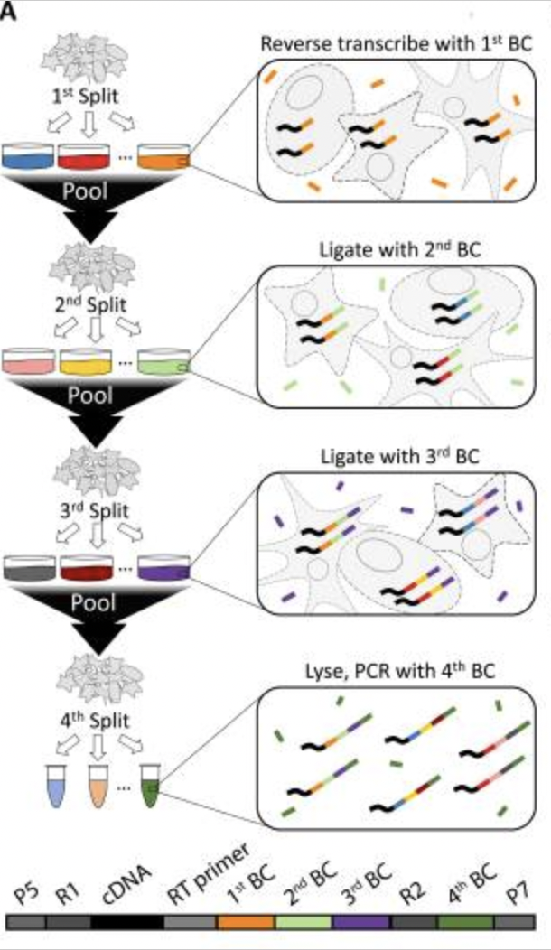
Single-cell RNA-seq using combinatorial indexing (e.g. SPLiT-seq, ParseBio)
First barcode is added via oligo-dT or random hexamer priming
2nd and 3rd barcodes are added sequentially after a pooling and splitting of cells
4th barcode is compatible with Illumina sample multiplexing
Each of these corresponds to one “sublibrary”, ie a unique collection of BC1-BC2-BC3 combinations
Watch movie here to understand better:
https://www.youtube.com/watch?v=WqaeZe7mKUc
Also see: sci-seq
Rosenberg, et al, Science, 2018

Slide 14
Benefits to combinatorial indexing strategies
Can process hundreds of thousands or even millions of cells simultaneously from multiple conditions
No special equipment needed (plate-based)
Transcripts amplified via oligo-dT and random hexamers
PolyA/3’ end plus sequences internal to transcript
Cheap per cell and scalable
Minimal batch effects given parallel sample processing
Compatible with both fresh and fixed cells or nuclei
See here for one solution for processing data of this type:
https://combine-lab.github.io/alevin-fry-tutorials/2022/split-seq/

Slide 15
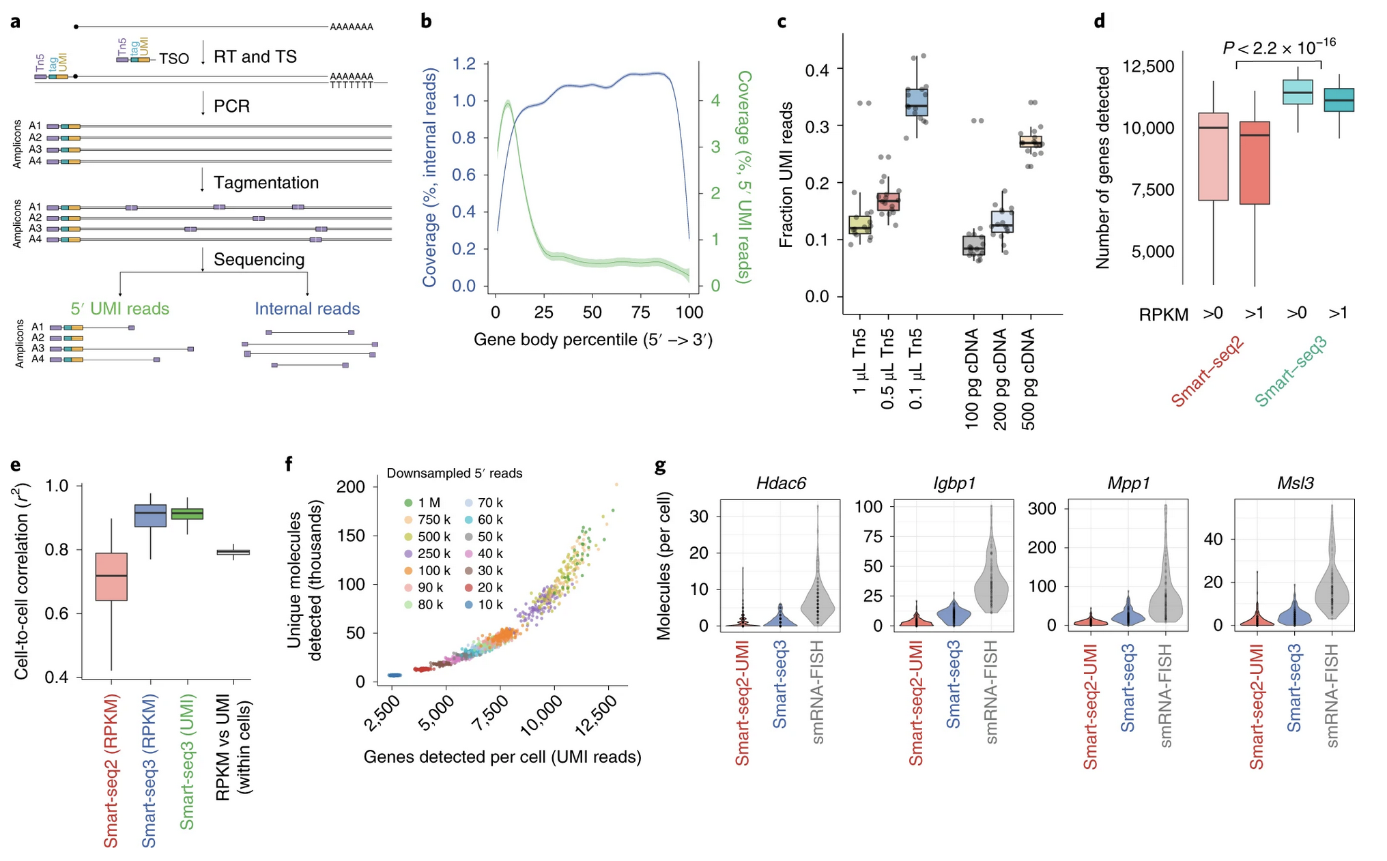
Single-cell RNA-seq with full-length transcripts using Smart-seq
https://doi.org/10.1038/s41587-020-0497-0

Slide 16
Single-cell multi-omics and/or spatial approaches
RNA + ATAC (chromatin accessibility)
RNA + cell surface protein expression (CITE-seq)
RNA + TCR
Protein-DNA interactions + cell surface protein expression (scCUT&Tag-Pro)
RNA + spatial
ATAC + spatial
…etc

Slide 17
Best practices for experimental design
Replicates, replicates, replicates!
Some (incorrectly) argue that since each cell is a replicate of the next, you don’t need true biological replicates
Best approach: multiple human tissue samples, multiple mice, multiple cell culture plates, etc per condition group
Variability in expression, and especially in cell proportions assigned to each cell type, is unfortunately quite large
I recommend labs do >3 replicates/samples per condition to capture and account for this variability
Each replicate should have several thousand cells sequenced targeting >50k reads/cell, I recommend >10k cells per condition
Atlas-scale studies usually require far more cells to capture the diverse cellular landscape

Slide 18
Best practices for experimental design
Control for batch effects!
10X can only isolate one sample at a time by default
Often the only option for patient-derived samples
This means separate isolations for different experimental conditions- a major confounder in doing any statistics, and one that can’t be explicitly corrected
Newer “Cell Hashing” (hashtag oligo, HTO) approaches allow for multiplexing, but may not work for certain cell types as it is antibody/lipid mediated, and costs extra
Encourage collaborators to at least obtain e.g. WT_rep1 and MUT_rep1 on the same day (+same reagent kit, experimenter) if multiplexing is not possible
Other non-10X solutions (e.g. SPLiT-seq/ParseBio) may be more appropriate for complex experimental setups with multiple conditions, for tissues where Cell Hashing is less effective, or for cases when many (>100k) cells are needed

Slide 19
Other considerations
Unknown whether cell size plays a role in isolation. Do larger cells get stuck in microfluidics channels and not get discovered? You only get what you get…
Data are very sparse, lots of 0s. Essentially probing expression of only top 10-20% expressed genes
If lab is interested in genes known to be lowly expressed (many transcription factors are!), droplet-based scRNA-seq may not be appropriate
Can sequence whole cells or just nuclei
This is especially relevant for cell type annotation, nuclear vs cytoplasmic expression patterns can be very different!
5’ vs 3’ chemistry
Which end of the transcript is sequenced?
Data processing is different depending on this!
Only 5’ is compatible with VDJ workflow for TCR repertoire analysis

Slide 20
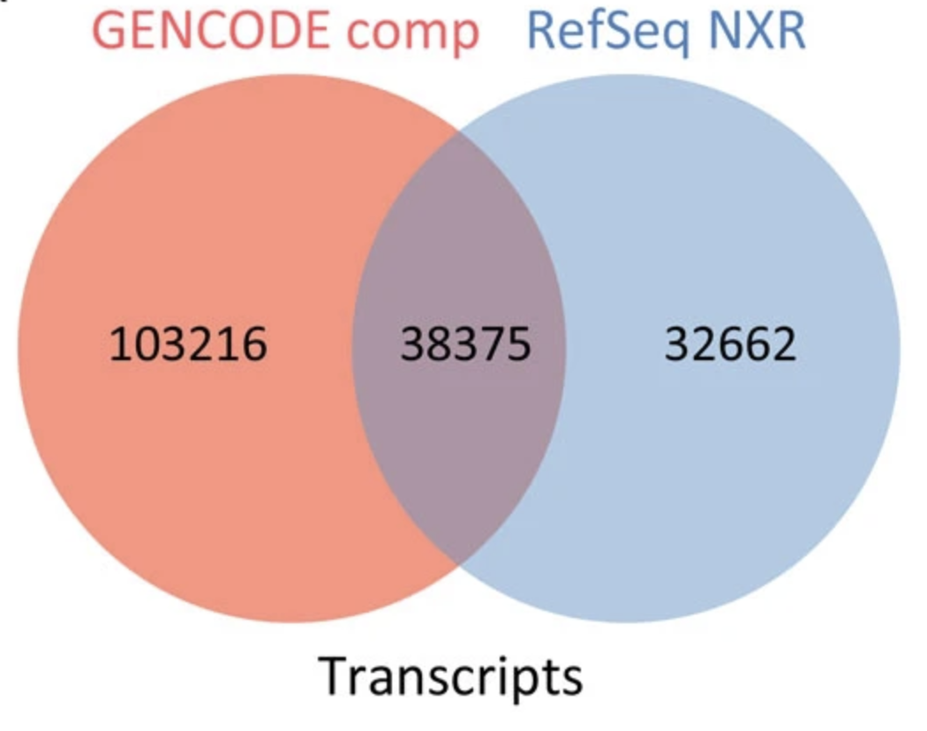
YOAGAYA :: You’re Only As Good As Your Annotations
Use an appropriate, updated, and most importantly CONSTANT reference genome and gene annotations for all samples for a given study
UCSC/RefSeq vs GENCODE/Ensembl
GENCODE is more comprehensive, therefore gives the best chance for a read to align and be counted appropriately
GENCODE updated ~2-3x per year
Spliced, unspliced, ambiguous counts
Spliced: reads that map to splice junctions
Unspliced: reads that map to introns
Ambiguous: reads that map entirely in an exon
Advantageous to include Unspliced reads, and is now default in CellRanger >= v7
Genome vs Transcriptome vs Splici annotation governs how these reads are counted and allocated
Frankish et al, BMC Genomics, 2015
https://doi.org/10.1371/journal.pcbi.1008585
https://combine-lab.github.io/alevin-fry-tutorials/2021/improving-txome-specificity/ https://www.10xgenomics.com/support/software/cell-ranger/latest/miscellaneous/cr-intron-mode-rec
https://pyroe.readthedocs.io/en/latest/building_splici_index.html#preparing-a-spliced-intronic-transcriptome-reference

Slide 21
alevin-fry: Open-source alternative to CellRanger
My preference for single-cell data processing
Written and supported by Rob Patro’s lab
Same group that wrote Salmon for bulk RNA-seq transcript quantification
Alevin, alevin-fry, roe/pyroe/roers are within the salmon ecosystem
Flexible regarding read/barcode geometries, even custom
Therefore can easily handle data from 10X, SPLiT-seq/ParseBio, and others
Can also process spatial transcriptomic data (e.g. 10X Visium)
Can process hashed/multiplexed samples (HTO), CITE-seq, etc
Tons of helpful tutorials/vignettes, active and responsive github community
Deployable and scalable with helpful wrappers
simpleaf (https://github.com/COMBINE-lab/simpleaf)
Nextflow (https://github.com/COMBINE-lab/quantaf)
nf-core scrnaseq (https://nf-co.re/scrnaseq)
https://alevin-fry.readthedocs.io/en/latest/
https://combine-lab.github.io/alevin-fry-tutorials/#blog
https://github.com/COMBINE-lab/salmon/

Slide 22
Part II
Introduction to scRNA-seq data pre-processing with alevin-fry

Slide 23
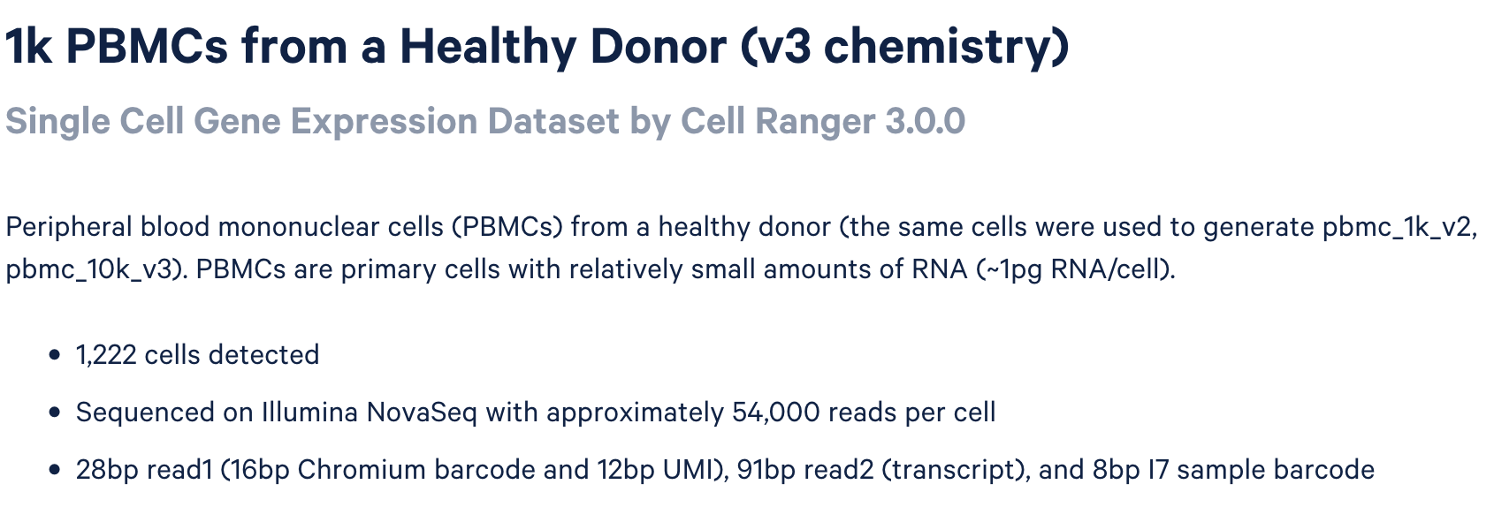
Example data: 1k PBMC 10X, 3’, v3 chemistry
Notes:
V2 chemistry is similar, except it has 16bp barcode + 10bp UMI
5’ libraries utilize V2 chemistry
https://www.10xgenomics.com/datasets/1-k-pbm-cs-from-a-healthy-donor-v-3-chemistry-3-standard-3-0-0

Slide 24
Software required
piscem
https://github.com/COMBINE-lab/piscem
https://github.com/COMBINE-lab/piscem/releases/tag/v0.10.3
conda install piscem will work for many users
roers
https://github.com/COMBINE-lab/roers
First install Rust (https://doc.rust-lang.org/cargo/getting-started/installation.html)
You may need to add the installation directory to your $PATH environmental variable
e.g. add export PATH=$PATH:/Users/jsimon/.local/bin to your .bashrc or .bash_profile
Then run cargo install roers
alevin-fry
https://alevin-fry.readthedocs.io/en/latest/index.html
https://github.com/COMBINE-lab/alevin-fry
conda install alevin-fry

Slide 25
Download example data (FASTQ format)
# Make working directory for workshop
mkdir HSPH_scRNA_20241023
cd HSPH_scRNA_20241023
# Download 10x FASTQ files
curl -s -O https://cf.10xgenomics.com/samples/cell-exp/3.0.0/pbmc_1k_v3/pbmc_1k_v3_fastqs.tar
# Un-tar FASTQ files
tar -xvf pbmc_1k_v3_fastqs.tar
# Peek at one of the R1 files
zcat < pbmc_1k_v3_fastqs/pbmc_1k_v3_S1_L001_R1_001.fastq.gz | head -n 24
# Peek at one of the R2 files
zcat < pbmc_1k_v3_fastqs/pbmc_1k_v3_S1_L001_R2_001.fastq.gz | head -n 24
Note: There are 2 lanes (L001, L002) of sequencing. In this case, these files can be concatenated, either explicitly by us (cat) or implicitly during our first processing step (*R1*.gz, *R2*.gz)

Slide 26
Download reference genome and GENCODE gene annotation
# Download reference genome sequence (Takes ~20 min to download)
curl -s -O https://ftp.ebi.ac.uk/pub/databases/gencode/Gencode_human/release_45/GRCh38.primary_assembly.genome.fa.gz
# Download GENCODE GTF of gene annotations
curl -s -O https://ftp.ebi.ac.uk/pub/databases/gencode/Gencode_human/release_45/gencode.v45.annotation.gtf.gz
Links accessible on GENCODE website here:
https://www.gencodegenes.org/human/
Or similarly for mouse:
https://www.gencodegenes.org/mouse/
Make sure you don’t mix and match releases!
Human v45 release is built on GRCh38/hg38
Earlier releases are needed if using hg19
More info here: https://www.gencodegenes.org/human/releases.html

Slide 27
Generate splici annotation
Run roers
roers make-ref -a intronic --filename-prefix splici_roers GRCh38.primary_assembly.genome.fa gencode.v45.annotation.gtf gencode.v45.annotation_splici_roers
What is a splici annotation? And why do we do it this way? Read more here:
https://www.sc-best-practices.org/introduction/raw_data_processing.html#mapping-to-an-augmented-transcriptome
Note: there exists an alternative path via pyroe but this seems to be the preferred tool moving forward

Slide 28
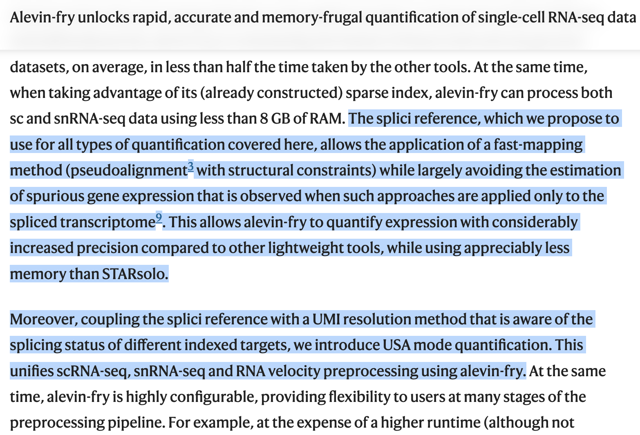
He, et al., 2022

Slide 29
Index splici annotation with piscem
# Increase number of simultaneous open filehandles
ulimit -n 2048
# Run piscem build (takes ~20 minutes)
piscem build \
-s gencode.v45.annotation_splici_roers/splici_roers.fa \
--output gencode.v45.annotation_splici_roers_piscem_idx \
-t 4 2> gencode.v45.annotation_splici_roers_piscem_idx.log
Input: splici FASTA
Output: piscem index

Slide 30
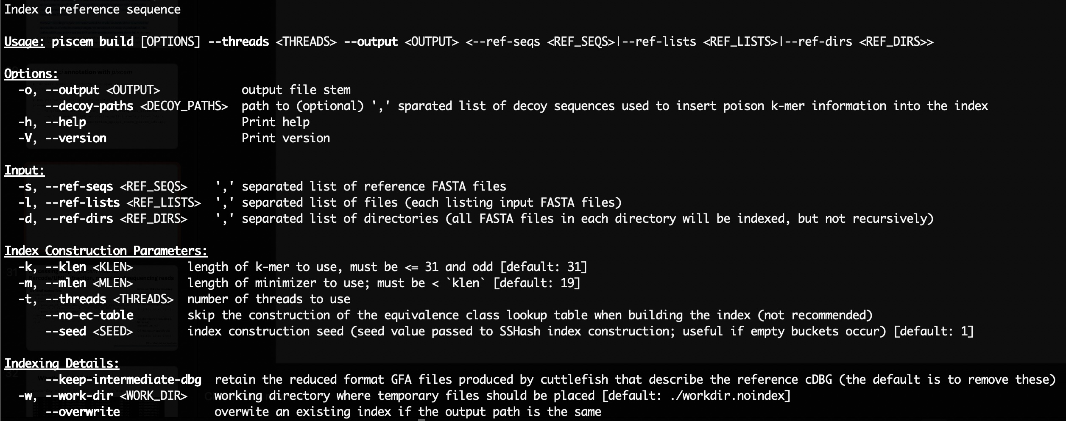
piscem build

Slide 31
Processing step 1: piscem map-sc Barcode/UMI extraction, mapping of sequencing reads
General execution:
piscem map-sc \
-i gencode.v45.annotation_splici_roers_piscem_idx \
-1 pbmc_1k_v3_fastqs/pbmc_1k_v3_S1_L001_R1_001.fastq.gz,
pbmc_1k_v3_fastqs/pbmc_1k_v3_S1_L002_R1_001.fastq.gz \
-2 pbmc_1k_v3_fastqs/pbmc_1k_v3_S1_L001_R2_001.fastq.gz,
pbmc_1k_v3_fastqs/pbmc_1k_v3_S1_L002_R2_001.fastq.gz \
--geometry chromium_v3 \
-o 1k_PBMC_piscem_out \
-t 4
Note on 10X chemistries:
V3 chemistry
chromium_V3
OR manually specify via
1{b[16]u[12]x:}2{r:}
V2 chemistry (including 5’ libraries) chromium_v2
OR manually specify via
1{b[16]u[10]x:}2{r:}
Input: FASTQs, piscem index
Output: RAD file of alignments
Other chemistries, see here: https://github.com/COMBINE-lab/piscem/blob/main/README.md#geometry

Slide 32
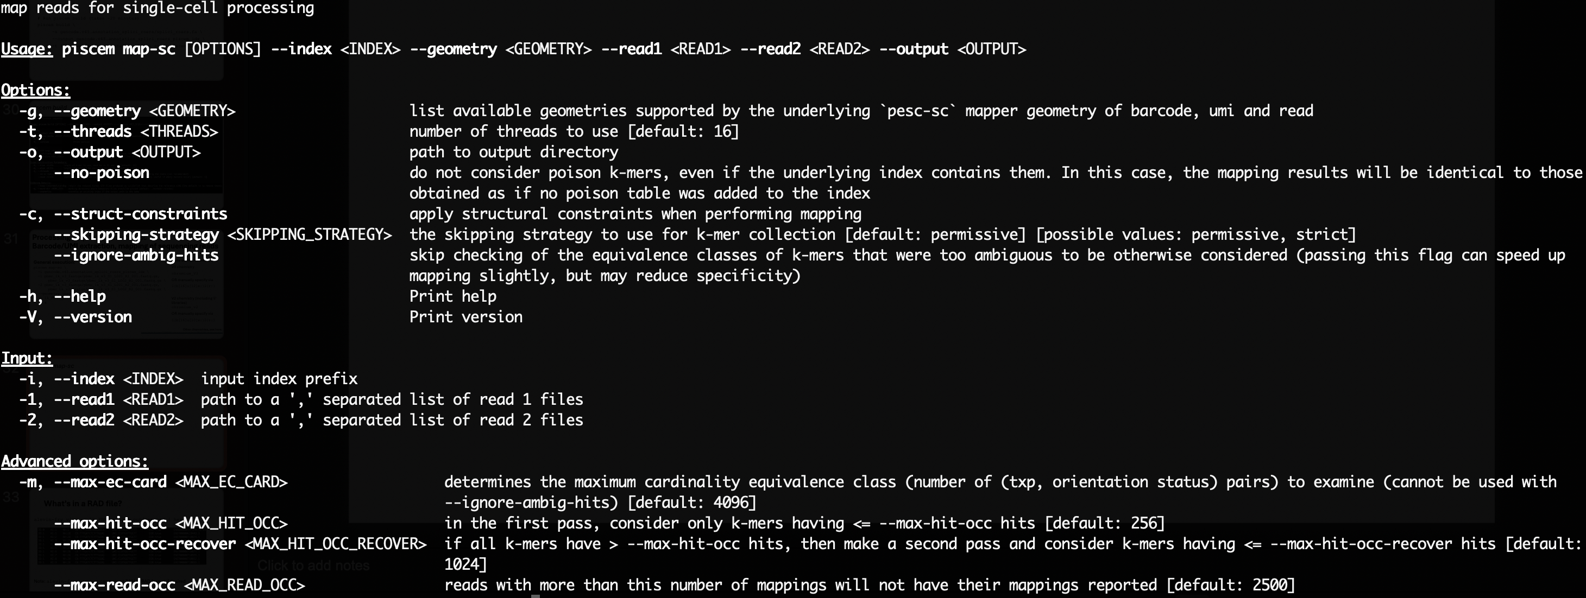
piscem map-sc

Slide 33
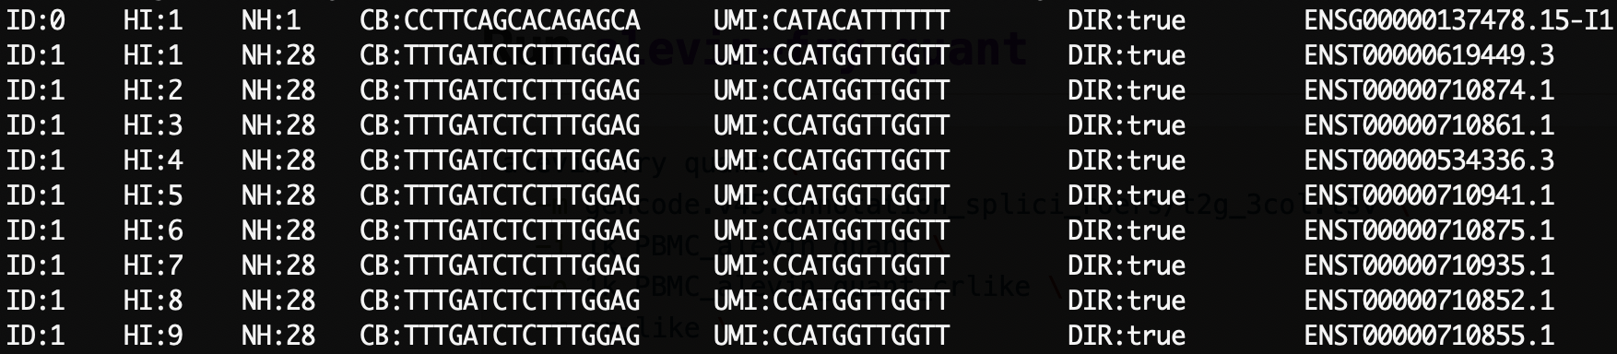
What’s in a RAD file?
alevin-fry view -r 1k_PBMC_piscem_out/map.rad | head
Note: alevin-fry convert can convert BAM to RAD format if desired

Slide 34
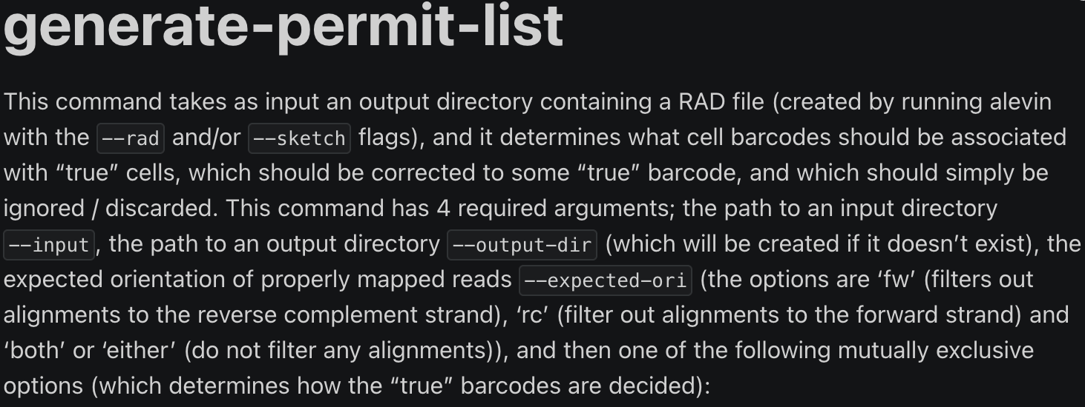
Processing step 2: alevin-fry generate-permit-list
Note on 10X chemistries:
3’ libraries must utilize
-d fw
5’ libraries must utilize
-d rc
More information here:
https://github.com/COMBINE-lab/alevin-fry/issues/118
General execution:
alevin-fry generate-permit-list \
-d fw \
-k \
-i 1k_PBMC_piscem_out \
-o 1k_PBMC_alevin_quant
Input: piscem alignment directory, expected orientation, method to use for determining cells (“knee”)
Output: Directory containing “include list” of barcodes to keep
Optional: include --expect-cells 8000 or some other value based on known loading of 10X instrument

Slide 35
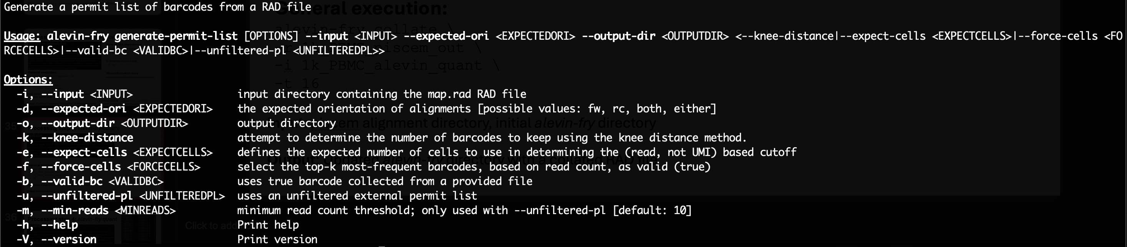
alevin-fry generate-permit-list

Slide 36
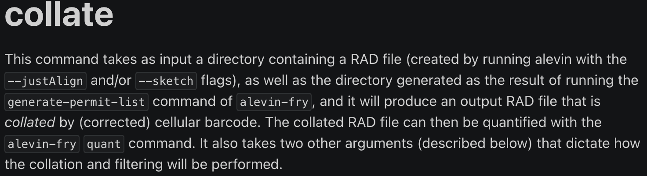
Processing step 3: alevin-fry collate
General execution:
alevin-fry collate \
-r 1k_PBMC_piscem_out \
-i 1k_PBMC_alevin_quant \
-t 16
Input: piscem alignment directory, initial alevin-fry directory
Output: Updated alevin-fry directory with a collated RAD file

Slide 37
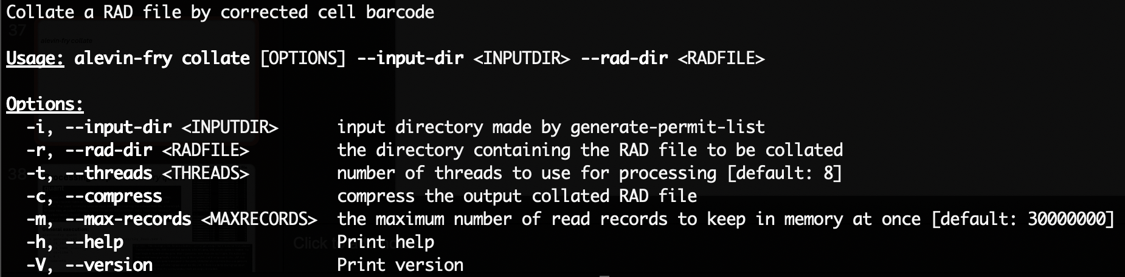
alevin-fry collate

Slide 38
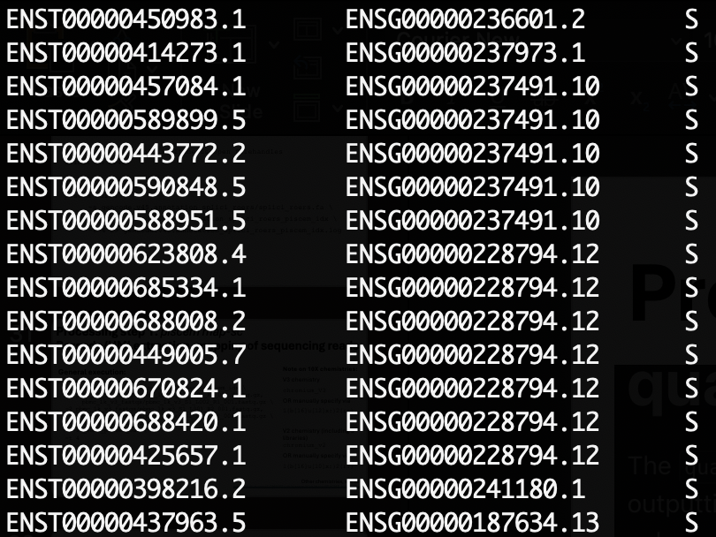
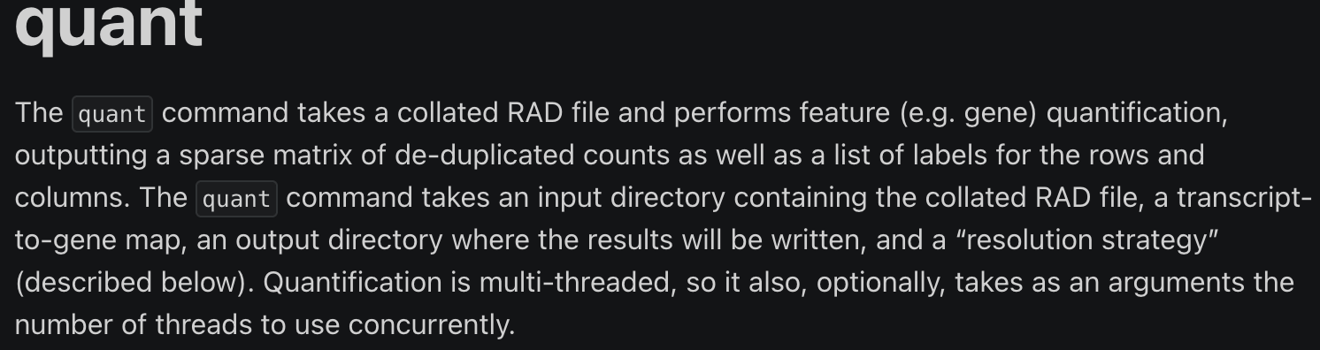
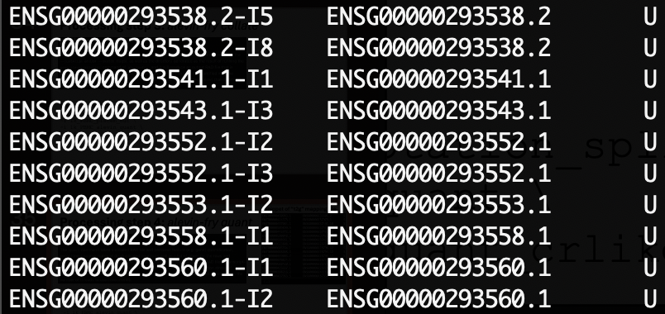
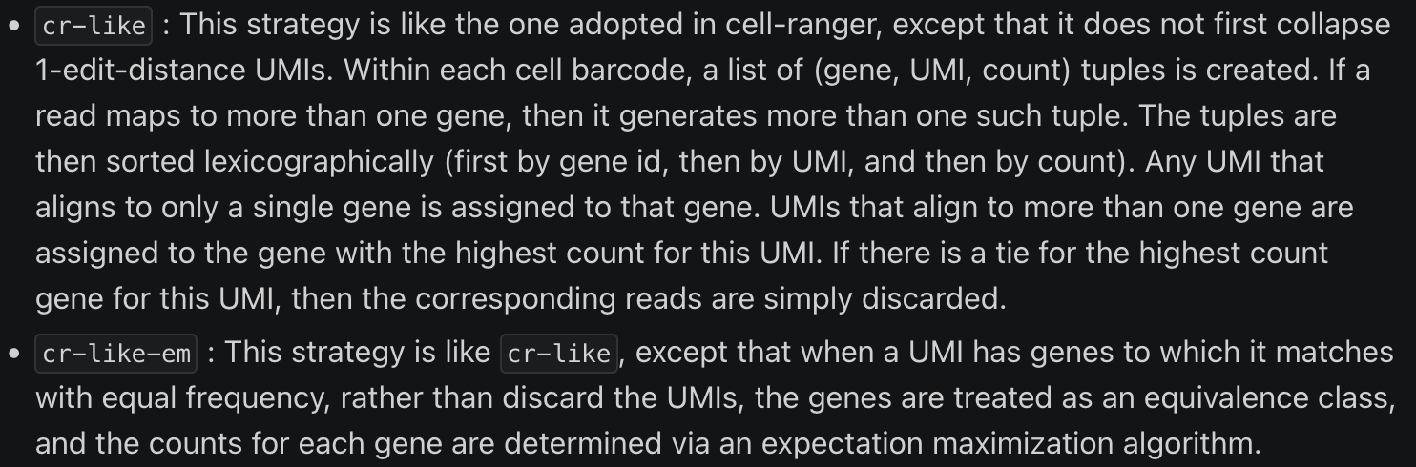
Processing step 4: alevin-fry quant
Snippet of “t2g” mapping file
[…]
General execution:
alevin-fry quant \
-m gencode.v45.annotation_splici_roers/t2g_3col.tsv \
-i 1k_PBMC_alevin_quant \
-o 1k_PBMC_alevin_quant_crlike \
-r cr-like \
-t 4 \
--use-mtx
Input: alevin-fry directory with collated RAD, quantification strategy
Output: Directory with mtx, barcode list, transcript list

Slide 39
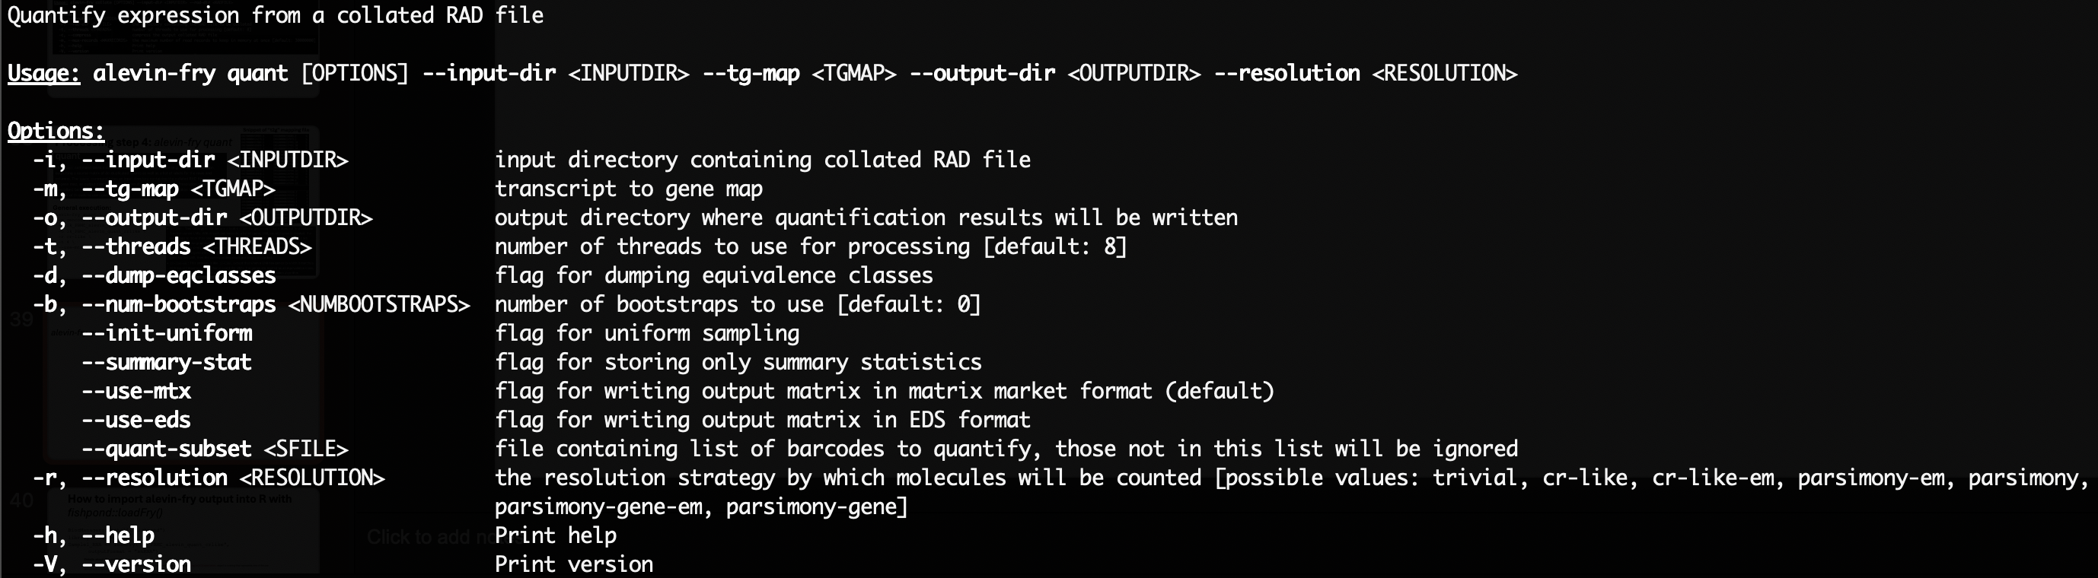
alevin-fry quant

Slide 40
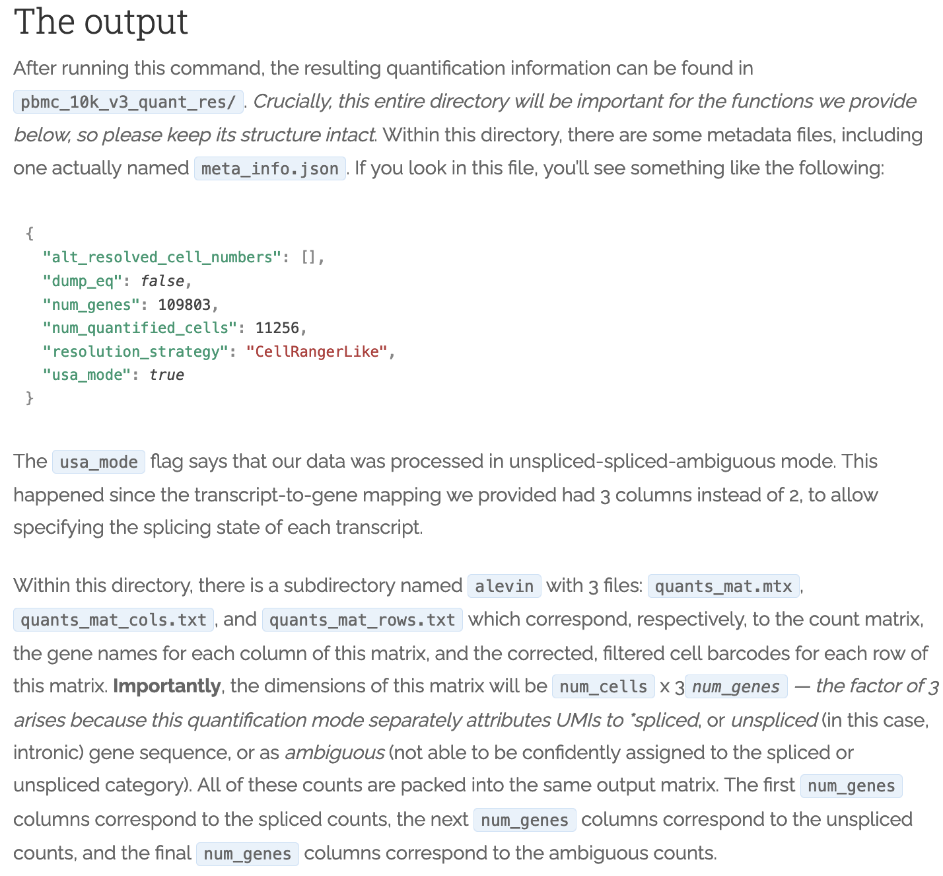
alevin-fry quant output
https://combine-lab.github.io/alevin-fry-tutorials/2021/improving-txome-specificity/

Slide 41
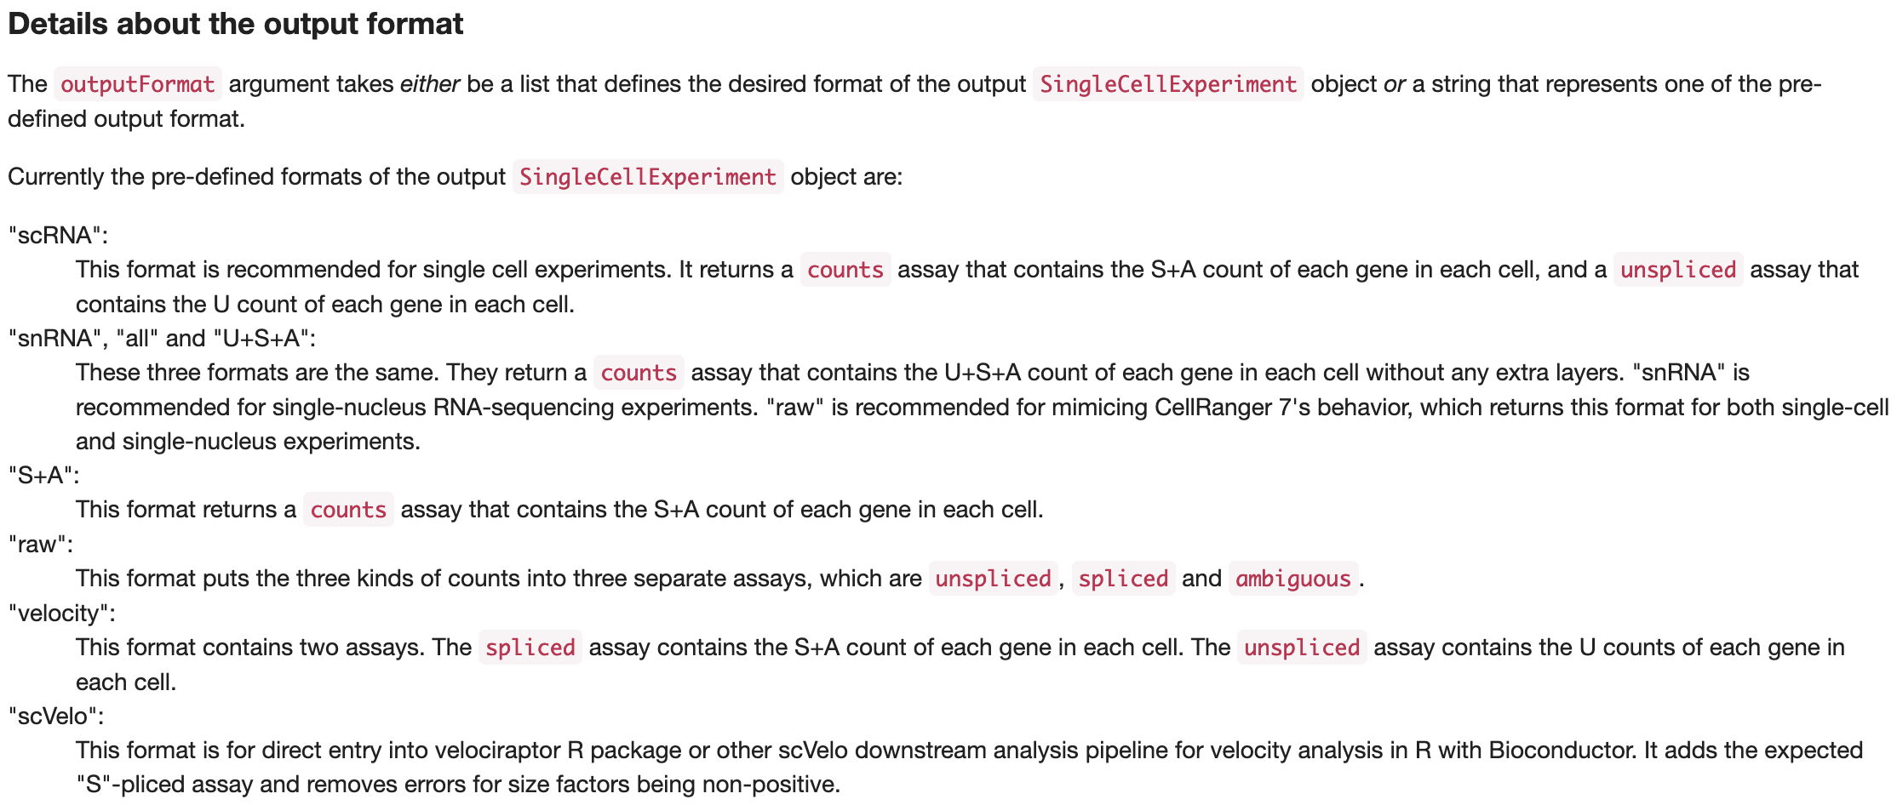
How to import alevin-fry output into R with fishpond::loadFry()
BiocManager::install("fishpond")
library(fishpond)
Sample1_RNA <- loadFry("1k_PBMC_alevin_quant_crlike",
outputFormat = "snRNA")

Slide 42
Should I use “snRNA” (U+S+A) or “scRNA”? (S+A)
In short, this choice is still up for debate. Results can differ!
I tend to choose to be comprehensive (“U+S+A”) but you may prefer to be more conservative (“S+A”)
The most important thing is that our quantification should be aware and capable of separately labeling counts so that you can make an informed choice downstream
Especially if you are interested in splicing kinetics and/or RNA velocity measurements, this flavor of quantification allows you to get everything you need with one alignment step
Other methods historically required two alignment phases, one to get your “regular” abundance, and a separate one to measure velocity
This and more is under active discussion
https://www.biorxiv.org/content/10.1101/2023.01.04.522742v1
https://journals.plos.org/ploscompbiol/article?id=10.1371/journal.pcbi.1008585
…and more

Slide 43
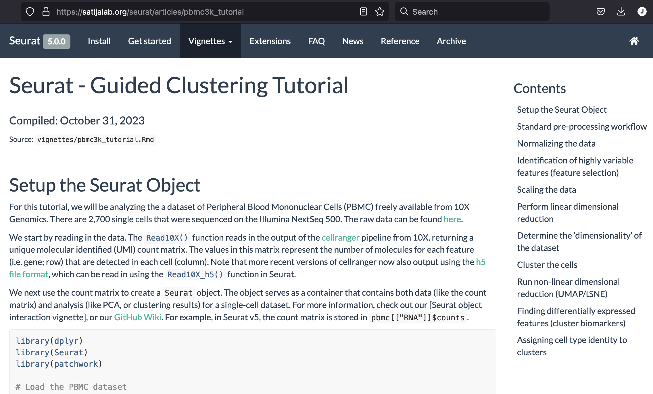
Follow basic Seurat analysis workflow
https://satijalab.org/seurat/articles/pbmc3k_tutorial
Note 1: This approach may or may not represent “Best Practices” for post-processing analysis. This part is merely for illustration purposes of how/where you can begin the workflow
Note 2: pyroe python package can also import alevin-fry outputs and prepare them as AnnData objects for scanpy if you prefer: https://pyroe.readthedocs.io/en/latest/processing_fry_quants.html

Slide 44
Full code and details available on GitHub
https://github.com/jeremymsimon/HSPH_scRNA_20241023

